Slide 1
The Role of Generalist Inventors in Team-Level Innovation
Kyuhun Lee

Slide 2
Research Question
Innovation is becoming increasingly team-oriented. (Wutchy et al., 2007)
The innovative outcome of the team is in part determined by the knowledge base of the team, and the pattern of how the knowledge is distributed within the team. (Singh & Fleming, 2010; Toh, 2014; Huo et al., 2019)
The composition of different types of human capital in a team, specifically the composition of specialists and generalists, can affect how knowledge is formed and processed within the team.
How do generalist inventors affect the team’s innovative performance?
What roles do they play in a team?

Slide 3
Literature Review
Studies on specialists/generalists and innovation
Jones, 2009: Inventors tend to specialize due to increasing burden of knowledge
Boh et al., 2014: Specialists make impactful inventions; generalists generate more inventions
Nagle & Teodoridis, 2019: Diversified inventors are better at exploration
Melero & Palomeras, 2015: Generalists can have a positive effect on team innovativeness, depending on domain uncertainty
Prior literature has not yet reached a consensus on whether generalists are better or worse at innovation. Moreover, most of the studies focus on individual-level output; the implication on team-level innovativeness is underexamined.

Slide 4
Theory & Hypotheses
Specialists and Generalists
Specialist
has deep knowledge in narrow expertise
close to the knowledge frontier in their field of expertise
has domain-specific skills (problem solving, memory, etc.)
depth
width
Generalist
has knowledge in a wide array of expertise, but lacks depth
has access to knowledge in various domains
has knowledge recombination skills
depth
width

Slide 5
Theory & Hypotheses
The effect of the proportion of generalists in a team on the impact of the innovation
On one hand, generalists can contribute to the innovativeness of the team output.
1) Generalists are better at knowledge recombination
Innovation involves recognizing and recombining existing knowledge
Generalists can utilize a wide array of expertise to recognize distant knowledge components and recombine them.
Generalists are better positioned to see the ‘big picture’: they can recognize distant pieces of knowledge and evaluate potential combinations better.
Generalists are cognitively flexible and have less of the ‘tunnel vision’ problem that specialists face.

Slide 6
Theory & Hypotheses
The effect of the proportion of generalists in a team on the impact of the innovation
On one hand, generalists can contribute to the innovativeness of the team output.
2) Generalists can facilitate teamwork
Team-level innovation calls for coordination of human capital, which can be costly.
Generalists can act as a ‘bridge’ between inventors
Generalists can also mitigate any free-rider problem that may arise by monitoring their peers’ efforts.
Hypothesis 1a: The proportion of generalist inventors in a team responsible for an innovation will have a positive effect on the impact of the innovation.

Slide 7
Theory & Hypotheses
The effect of the proportion of generalists in a team on the impact of the innovation
On the other hand, generalists may not be suited to team-level innovation as well as specialists.
1) Generalists lack the expertise that specialists have
Generalists have less depth in their expertise compared to specialists
Burden of knowledge (Jones 2009): In order to innovate on a technological field, one should first bring oneself to the frontier of knowledge through education.
As the stock of prior knowledge grows, the amount of knowledge that must be accumulated to reach the knowledge frontier in a certain domain also grows.
The depth of knowledge a generalist inventor has may not be sufficient to contribute towards a significant innovation.
In effect, generalist inventors will have little to add to the collective knowledge pool of the team.

Slide 8
Theory & Hypotheses
The effect of the proportion of generalists in a team on the impact of the innovation
On the other hand, generalists may not be suited to team-level innovation as well as specialists.
2) Generalists are less productive in team settings
Collaborative innovation calls for ‘division of labor’: each individual is expected to demonstrate their expertise in their respective domains, producing knowledge that can be recombined at the team level.
The expertise that generalists lack of includes not only the depth of knowledge on the domain, but also domain-specific problem-solving and memory skills.
The lack of domain-specific problem-solving and memory skills makes the generalist less productive in producing and combining knowledge within the domain.
Hypothesis 1b: The proportion of generalist inventors in a team responsible for an innovation will have a negative effect on the impact of the innovation.

Slide 9
Theory & Hypotheses
When can generalists perform better in a team?
Two roles that generalist inventors can play in a team: coordination and exploration
Coordination
Generalists can evaluate and recombine multidisciplinary knowledge better
Generalists can utilize this advantage to coordinate inventors from different backgrounds and help them overcome communication challenges.
Exploration
Generalists are not limited to a single set of knowledge and problem-solving skills
Generalists have access to a variety of knowledge sources and can employ a broad set of perspectives, making them better at tackling new or unfamiliar problems.
Thus, we can expect that generalists can perform better in a team when 1) coordination costs are high, or 2) the team engages in explorative activities.

Slide 10
Theory & Hypotheses
When can generalists perform better in a team?
When the technological distance between inventors in a team is far,
Inventors will have different sets of knowledge, skills, and ways of thinking
They may also use different jargons, making communication difficult
Monitoring potential free-riders will be difficult
Overall, the team will face higher coordination costs.
H2: When the technological distance between inventors in a team is far, the proportion of generalist inventors in the team will have a more positive effect on innovation impact, relative to when the technological distance is close.

Slide 11
Theory & Hypotheses
When can generalists perform better in a team?
When the team is innovating in an unfamiliar domain,
The innovation process is largely explorative.
Inventors are required to recognize and recombine valuable knowledge outside their domain of expertise
Inventors should approach the problem with various skills and perspectives
H3: When the team is innovating in an unfamiliar domain, the proportion of generalist inventors in the team will have a more positive effect on innovation impact, relative to when the team is innovating in a familiar domain.

Slide 12
Methodology
Data
Patents granted to Top 10 pharmaceutical firms (Pharmaceutical Executive, 2015)
By the USPTO (PatentsView)
In years 2011-2015
With at least 2 inventors
No inventor should have less than 5 prior patenting experience
Resulted in a sample of 2,285 patents

Slide 13
Methodology
Dependent Variable
Impact of innovation: # of forward citations the focal patent received, counted until 5 years from grant date
Independent Variable
Proportion of generalists in a team: number of generalist inventors divided by the number of inventors
To identify generalist inventors, I counted each inventor’s prior patenting experience in each CPC subclasses to get a vector representation of the inventor’s patent portfolio.
I calculated the HHI of the portfolio to measure the concentration level.
I labeled an inventor as a generalist if the inventor's HHI is below the 1st quartile (HHI=0.449)
(Also tested with bottom 10% HHI, or 0.289)

Slide 14
Methodology
Moderating Variables
(H2)
Mean technological distance: calculated as the mean of technological distance (1 – cosine similarity between patent portfolio vectors) for all possible inventor pairs
(H3)
Domain unfamiliarity: calculated as the proportion of inventors who have never patented in the focal patent’s subclass before
Mean difference in HHI: used as an alternative measure of domain familiarity
Control Variables
Firm sales (COMPUSTAT)
# of inventors, sum of prior patents, # of unique subclasses
# of backward citations, mean age of backward citation, self-citation ratio, # of claims
Firm, year, subclass dummies (subclass for OLS only)

Slide 15
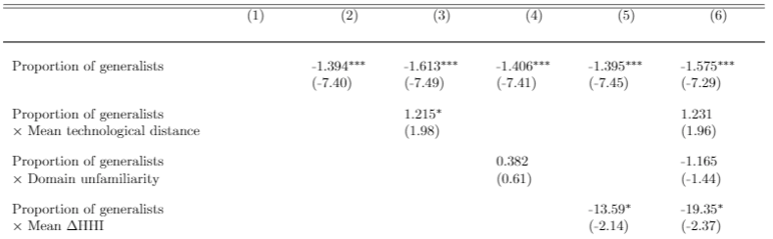
Results
Zero-inflated Negative Binomial Regression
H1b is supported
H2 is supported
H3 is partially supported
*Use of zero-inflated models was justified by HPC test (Santos Silva et al., 2015)

Slide 16
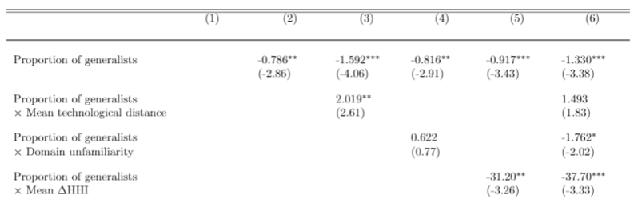
Results
Zero-inflated Negative Binomial Regression
(Generalists as bottom 10% HHI)
H1b is supported
H2 is supported
H3 is partially supported
*Use of zero-inflated models was justified by HPC test (Santos Silva et al., 2015)

Slide 17
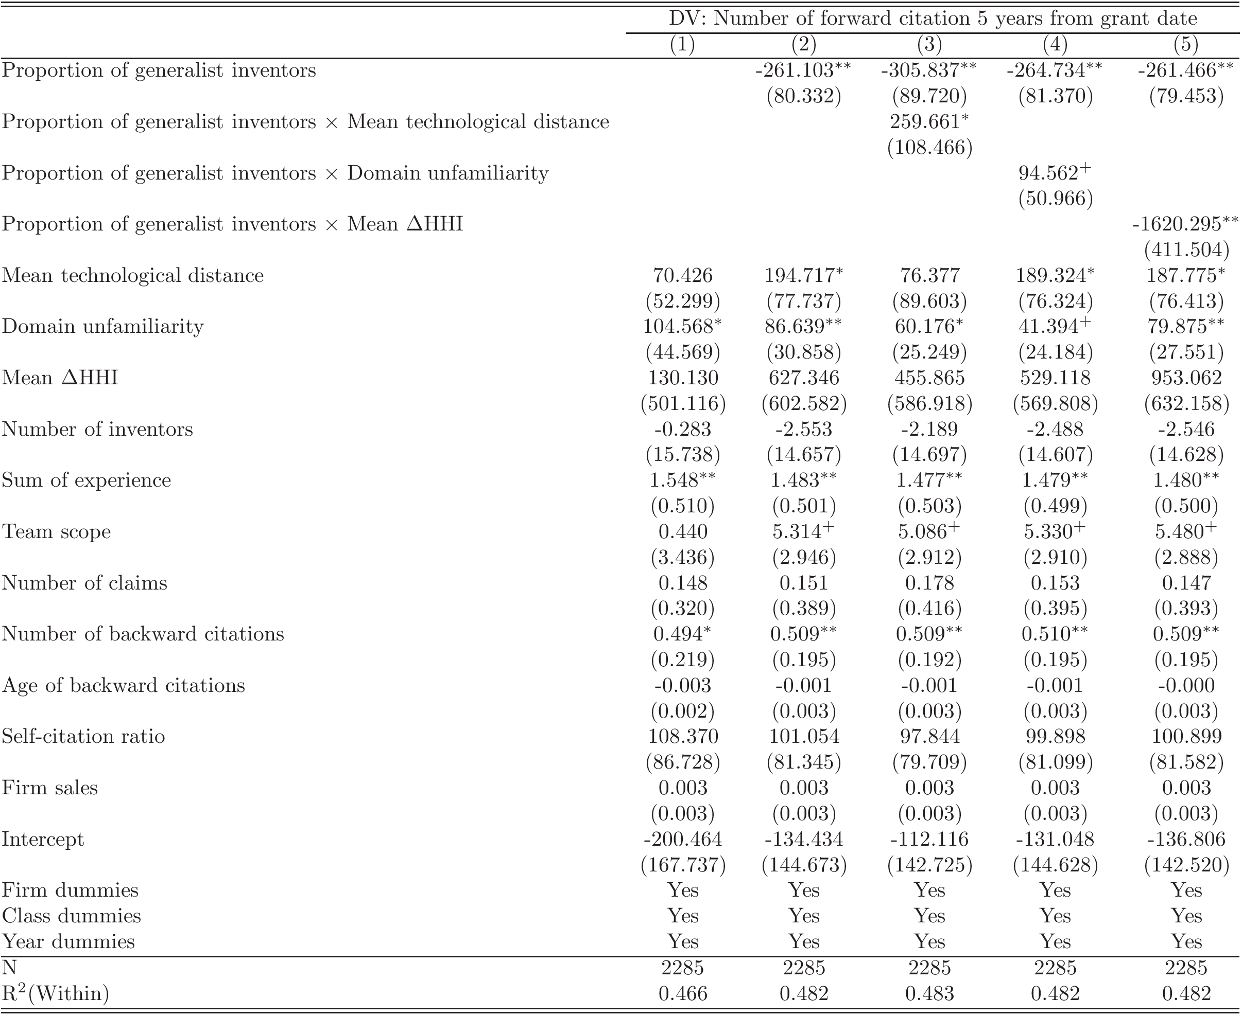
Results
OLS Regression with clustered(robust) standard errors

Slide 18
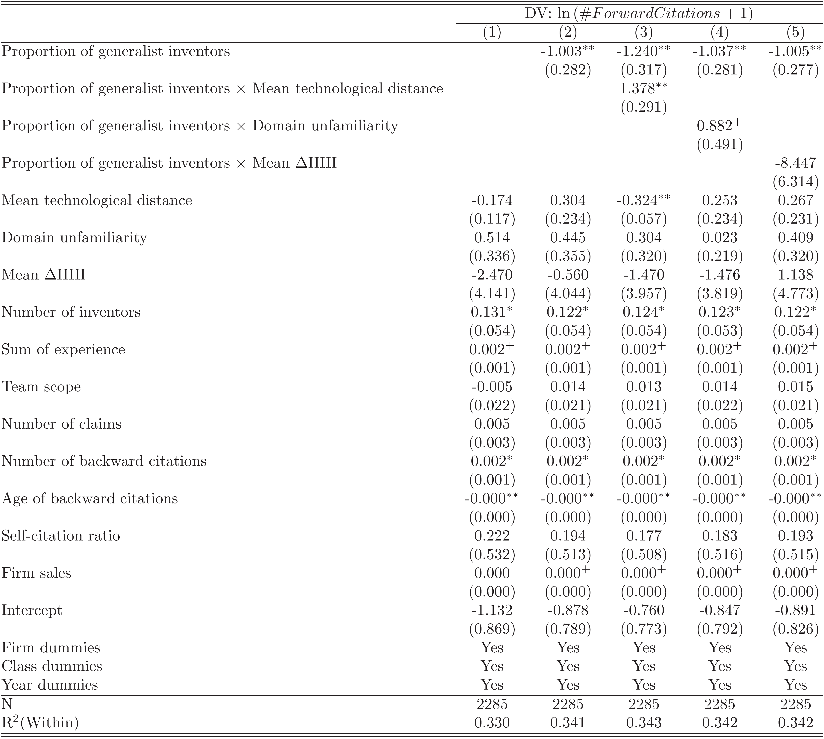
Results
OLS Regression on ln(DV+1)

